Slide 1

Project – Bike Collision Detection
Lesson 17
Planning and Requirements

Slide 2
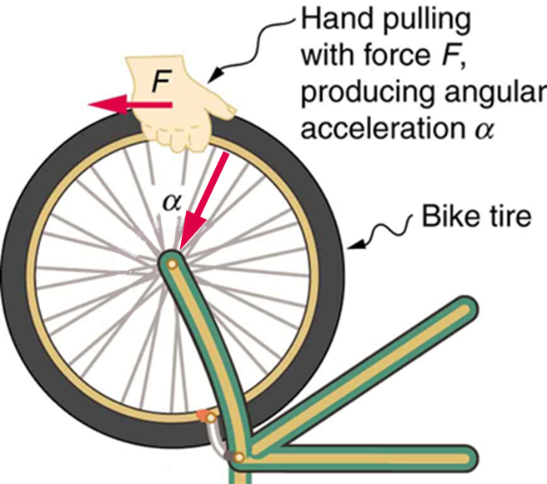
Acceleration and the Accelerometer
Acceleration = force / mass
As ride your bike, the mass does not change
However as you speed up, slow down, turn and brake the force will change
Therefore the new acceleration can be calculated and stored in a variable
Notes:
Introduce how Acceleration is measured

Slide 3
Program to Measure Acceleration on the x-axis
from microbit import *
while True:
reading = accelerometer.get_x()
if reading > 20:
display.show("R")
elif reading < -20:
display.show("L")
else:
display.show("-")
Notes:
Discuss the program,
A reading is taken and stored in the variable, then selection is used to compare the value to > 20 or < -20. The micro:bit responds with the direction shown in, either Right or Left.
Activity part 1

Slide 4
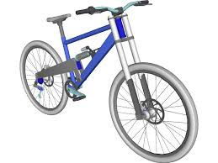
Bike Crash Detector
y
Imagine that you are riding your bike in a straight line and then you start to turn a left hand corner
As you lean to the left, this changes the speed or the direction or both so the acceleration changes
If your micro:bit was attached to your bike it would flash up the letter ‘L’
Complete the activity and build a bike crash detector
x
z
Notes:
Learners adapt micro:bit acceleration program to build bike crash detector.
Learners can build detector on all three axis.
Test with real bike or a pole to represent the frame.

Slide 5
Success Criteria
The micro:bit responds to acceleration on one of the axes, x, y or z
The micro:bit responds to acceleration on a combination of two of the axes, x, y or z
The micro:bit responds to acceleration on all three axes
The responses are standard, LED or scrolling text message
The response uses the music or speech warnings
The values used are suitable and tested
You stay safe on your bike

